Slide 1
What works for Special-Needs Learners
Explicit Instruction
Effective and Efficient Teaching
Anita L. Archer
Charles A. Hughes
A Review by Maryanne Parker

Slide 2
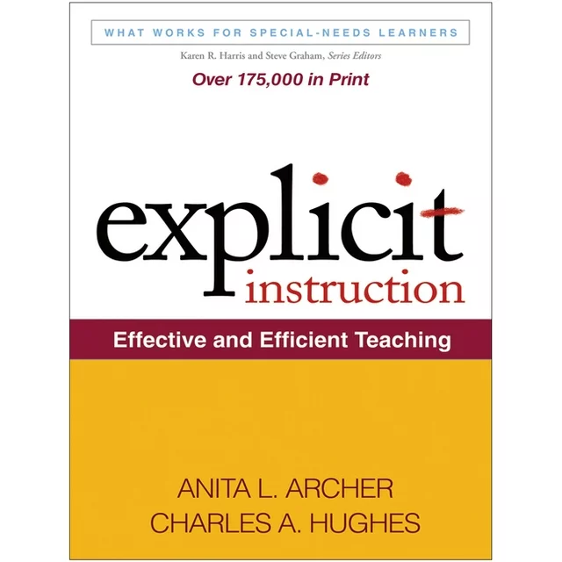
Who wouldn’t want a tool that helps to integrate explicit instruction into any grade level or content area?
Structured, direct, systematic and effective methodology for teaching academic skills.
Notes:
Archer and Hughes highlight that explicit instruction is…….

Slide 3
WHAT YOU GET
Offers clear guidelines for the identification of key concepts, skills, and routines that are crucial for effective teaching
Opportunities to practice and master new material
Includes: sample lesson plans, vibrant examples, and reproducible checklists and teacher worksheets.
Notes:
It goes further to provide insights into the art of designing and delivering impactful lessons, ensuring that educators can create an environment conducive to student success. Discusses the importance of providing ample opportunities…….
A plus was that…..it includes……with these resources, teachers can not only embrace but also excel in implementing explicit instruction, fostering a dynamic and enriching learning experience for their students.

Slide 4
WHY BUY THIS BOOK?
"Explicit Instruction: Effective and Efficient Teaching" is a comprehensive guide that highlights the importance of clear and direct teaching methods in the classroom.
If you want to enhance your teaching practices and improve student outcomes this is the book to help do that!
This Book Provides:
Practical strategies
Emphasis on frequent checks for understanding and immediate feedback
Promotes-modeling, guided practice, and independent practice to scaffold student learning and promote skill development
Easy implementation
Notes:
for educators to deliver instruction in a structured and engaging manner, focusing on breaking down complex concepts into manageable steps for students to comprehend effectively
By incorporating these strategies, educators can ensure that students are actively engaged in the learning process and receive timely support to address any misconceptions.
to create a supportive learning environment where all students can thriveThese strategies not only help students grasp new concepts but also empower them to apply their knowledge independently.
emphasizes the importance of clear, direct, and structured teaching methods to enhance student learning. It provides educators with strategies to deliver explicit instruction in a systematic and engaging manner. The book highlights the significance of breaking down complex skills and concepts into smaller, manageable steps, ensuring that students grasp each component before moving on. By incorporating frequent checks for understanding and providing immediate feedback, teachers can effectively support student learning and promote academic success. The book also emphasizes the use of modeling, guided practice, and independent practice to scaffold student learning effectively. Overall, "Explicit Instruction" serves as a valuable resource for educators looking to optimize their teaching practices and improve student outcomes.

Slide 5
Recommendation:
5 out of 5 stars
Comprehensive review of explicit instruction
Practical strategies
Guidelines to improve teaching practices
Website: https://explicitinstruction.org/
I particularly enjoyed the section that talked about prompting student responses because it's an area where I face challenges in my classroom. I've been experimenting with different approaches and have noticed some progress.

